Slide 1
EASY FOOD
Restaurant E-Commerce

Slide 2

Problem description
Easy Food Restaurants is an e-commerce business that allow Turonian's to access many restaurants for health and customize food around the city. Nowadays in Toronto, there are an enormous number of web sites that offer several foods but they do not offer health foods or food to people who need a special food. Easy food is able to concentrate expert’s restaurants in Vegan food, Vegetarian food and Special foods.

Slide 3
System capabilities
Combine a lot of restaurants into one exclusive site.
List a restaurant menu
Provides food delivery
Provides three types of payment: Credit card, Debts card or PayPal
Display a shopping cart where customers can see: prices, items and total prices
Displays the nutritional values ​​of each food

Slide 4
Business benefits
Customer saves time when looking for a suitable restaurant using the web application.
Customer saves money when looking for a restaurant because there is a quality assurance of the job. Furthermore, each restaurant will set its price for its services, offering a wide range of prices for the people to choose from.
Customer’s confidence towards the restaurant held by the system.
Increases restaurant reputation because will have best service for their customers.
Increases new business.

Slide 5
Scope
Project Title | Easy Food Restaurants
Project Purpose | The project is to offer a unique place for busy professional people to have access to balanced, delicious and healthy food.
Audience | Prospective Employers
People involved in the project | Franciele S. de Brito, Maria Rosa, Rodrigo Lima, Professor Reza Dibaj
Environment | ASP.Net, IIS, SQL Server.
Tools | Visual Studio 2017, SQL Server Management Studio

Slide 6
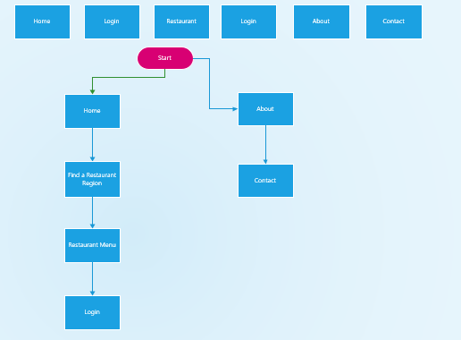
Page Description

Slide 7
Page description
1. Home Page | Welcome page. Customers can choose a restaurant region through address or zip code.
2. Login Page | User authentication
3. Restaurant Menu Page | A list of all restaurants, sorted by name, category and food type.
4. Restaurant Page | Each restaurant has its own page.
5. About Page | About our company
6. Contact Page | How to contact our company

Slide 8
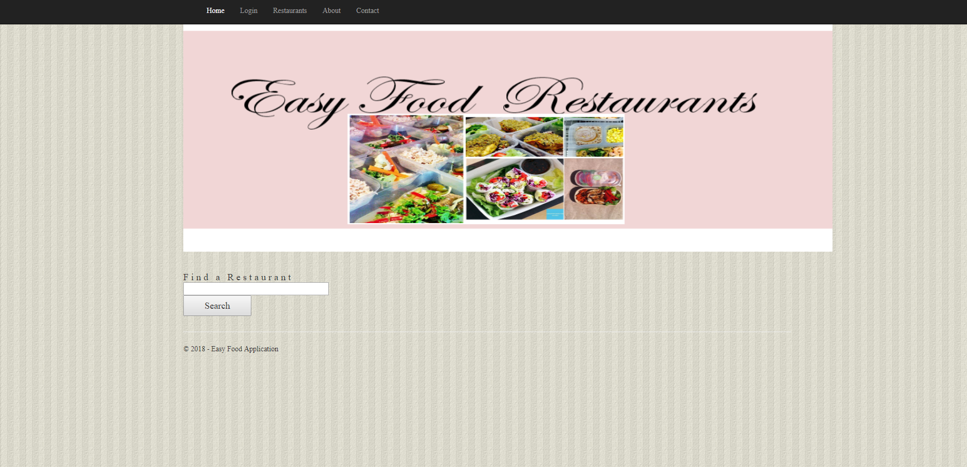
Home page

Slide 9
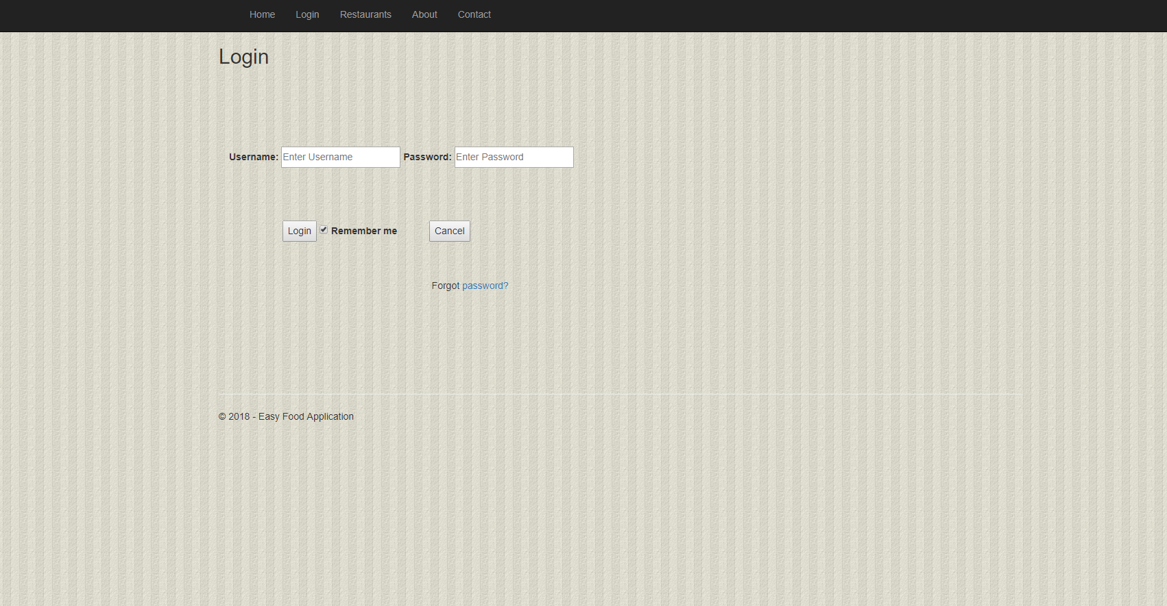
Login

Slide 10
Restaurant

Slide 11
Restaurant

